Slide 1
SOC MMC FPGA Board
Date 2007.5.28
SMT RnD Div 2

Slide 2
Contents
Block diagram
Schedule
Status
Software layer
Detailed block diagram
FPGA Board
8051 develop board
Issues

Slide 3
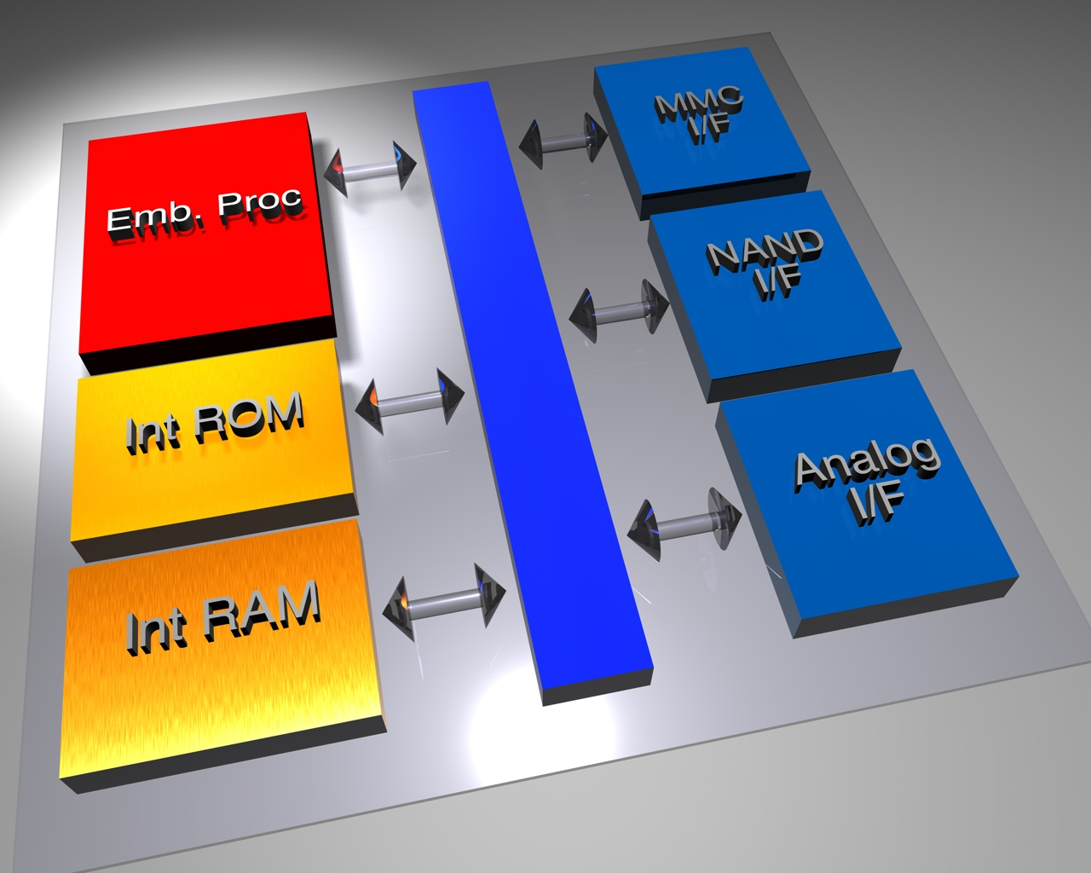
block diagram

Slide 4
일정
[Project : 11 months]
Unit: Month
기준시점
4/1
7/1
8/1
10/1
3 | 1 | 2 | 3 | 2
IP Design
FPGA Test
Top Test Sim
FAB Process
M/P Test
FPGA B’D
RTL Freeze
FAB Out
Completed
On-board Test

Slide 5
Status
9/30
12/31
6/1
7/1
IP Design
TOP Merge & Test
H/W
B/D Design
Board Test
On board test
BUS
NAND Flash memory controller design
8051 Interface block design
RS Encoder/Decoder design
GANG Board/ISP Env.
Eval. Board
S/W
On board test
S/W Layer 정의
FTL 분석/구현 진행 중
Command Parser
Low level coding

Slide 6
Software Layer
Host I/F (SD , MMC)
MMC Command
Manager
SD Command
Manager
Standard 분석 작업 진행 (30%)
Flash Translation Layer
S/W Layer 작업 진행 중 (70%)
NAND Manager
FTL Software 분석 및 코딩 (30%)
NAND Flash Memory
H/W
S/W

Slide 7
Block diagram
Internal
ROM
(5 K Bytes)
제거
PLL
DMA
GPIO
On Chip
OSC
8051
Internal
Bus
Internal
SRAM
(8 K Bytes)
VDT
POR
MMC/SD
Card
Interface
Regulator
???
ISP
NAND
Controller

Slide 8
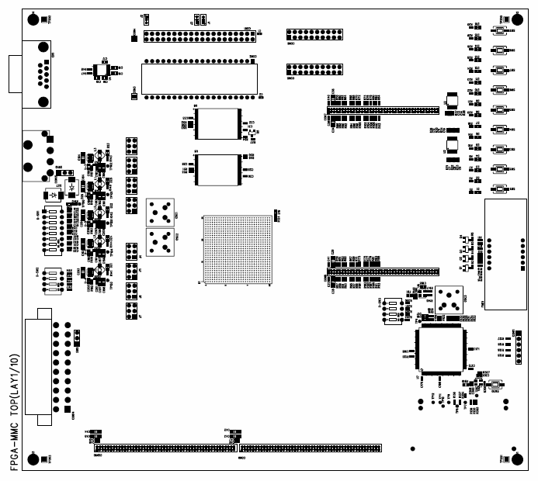
7 Seg 4 Digit
LED
40 Pin Socket
FPGA
V4LX60
40 Pin Socket
Power
ROM Emulator
Socket
OSC

Slide 9
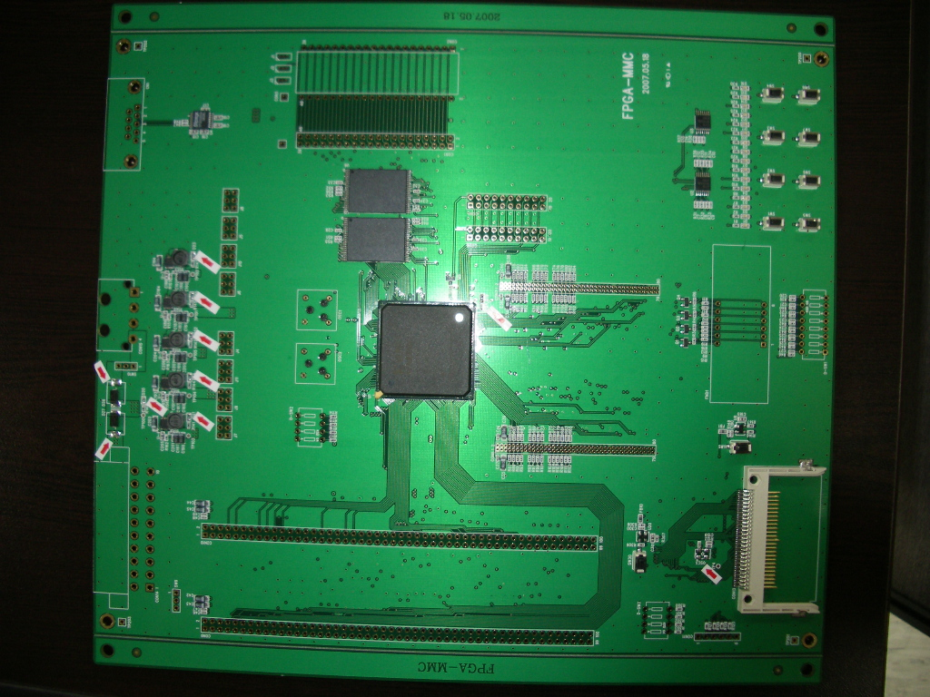
POWER
UART
Flash Socket
POWER
7 Segment
FPGA Configuration

Slide 10
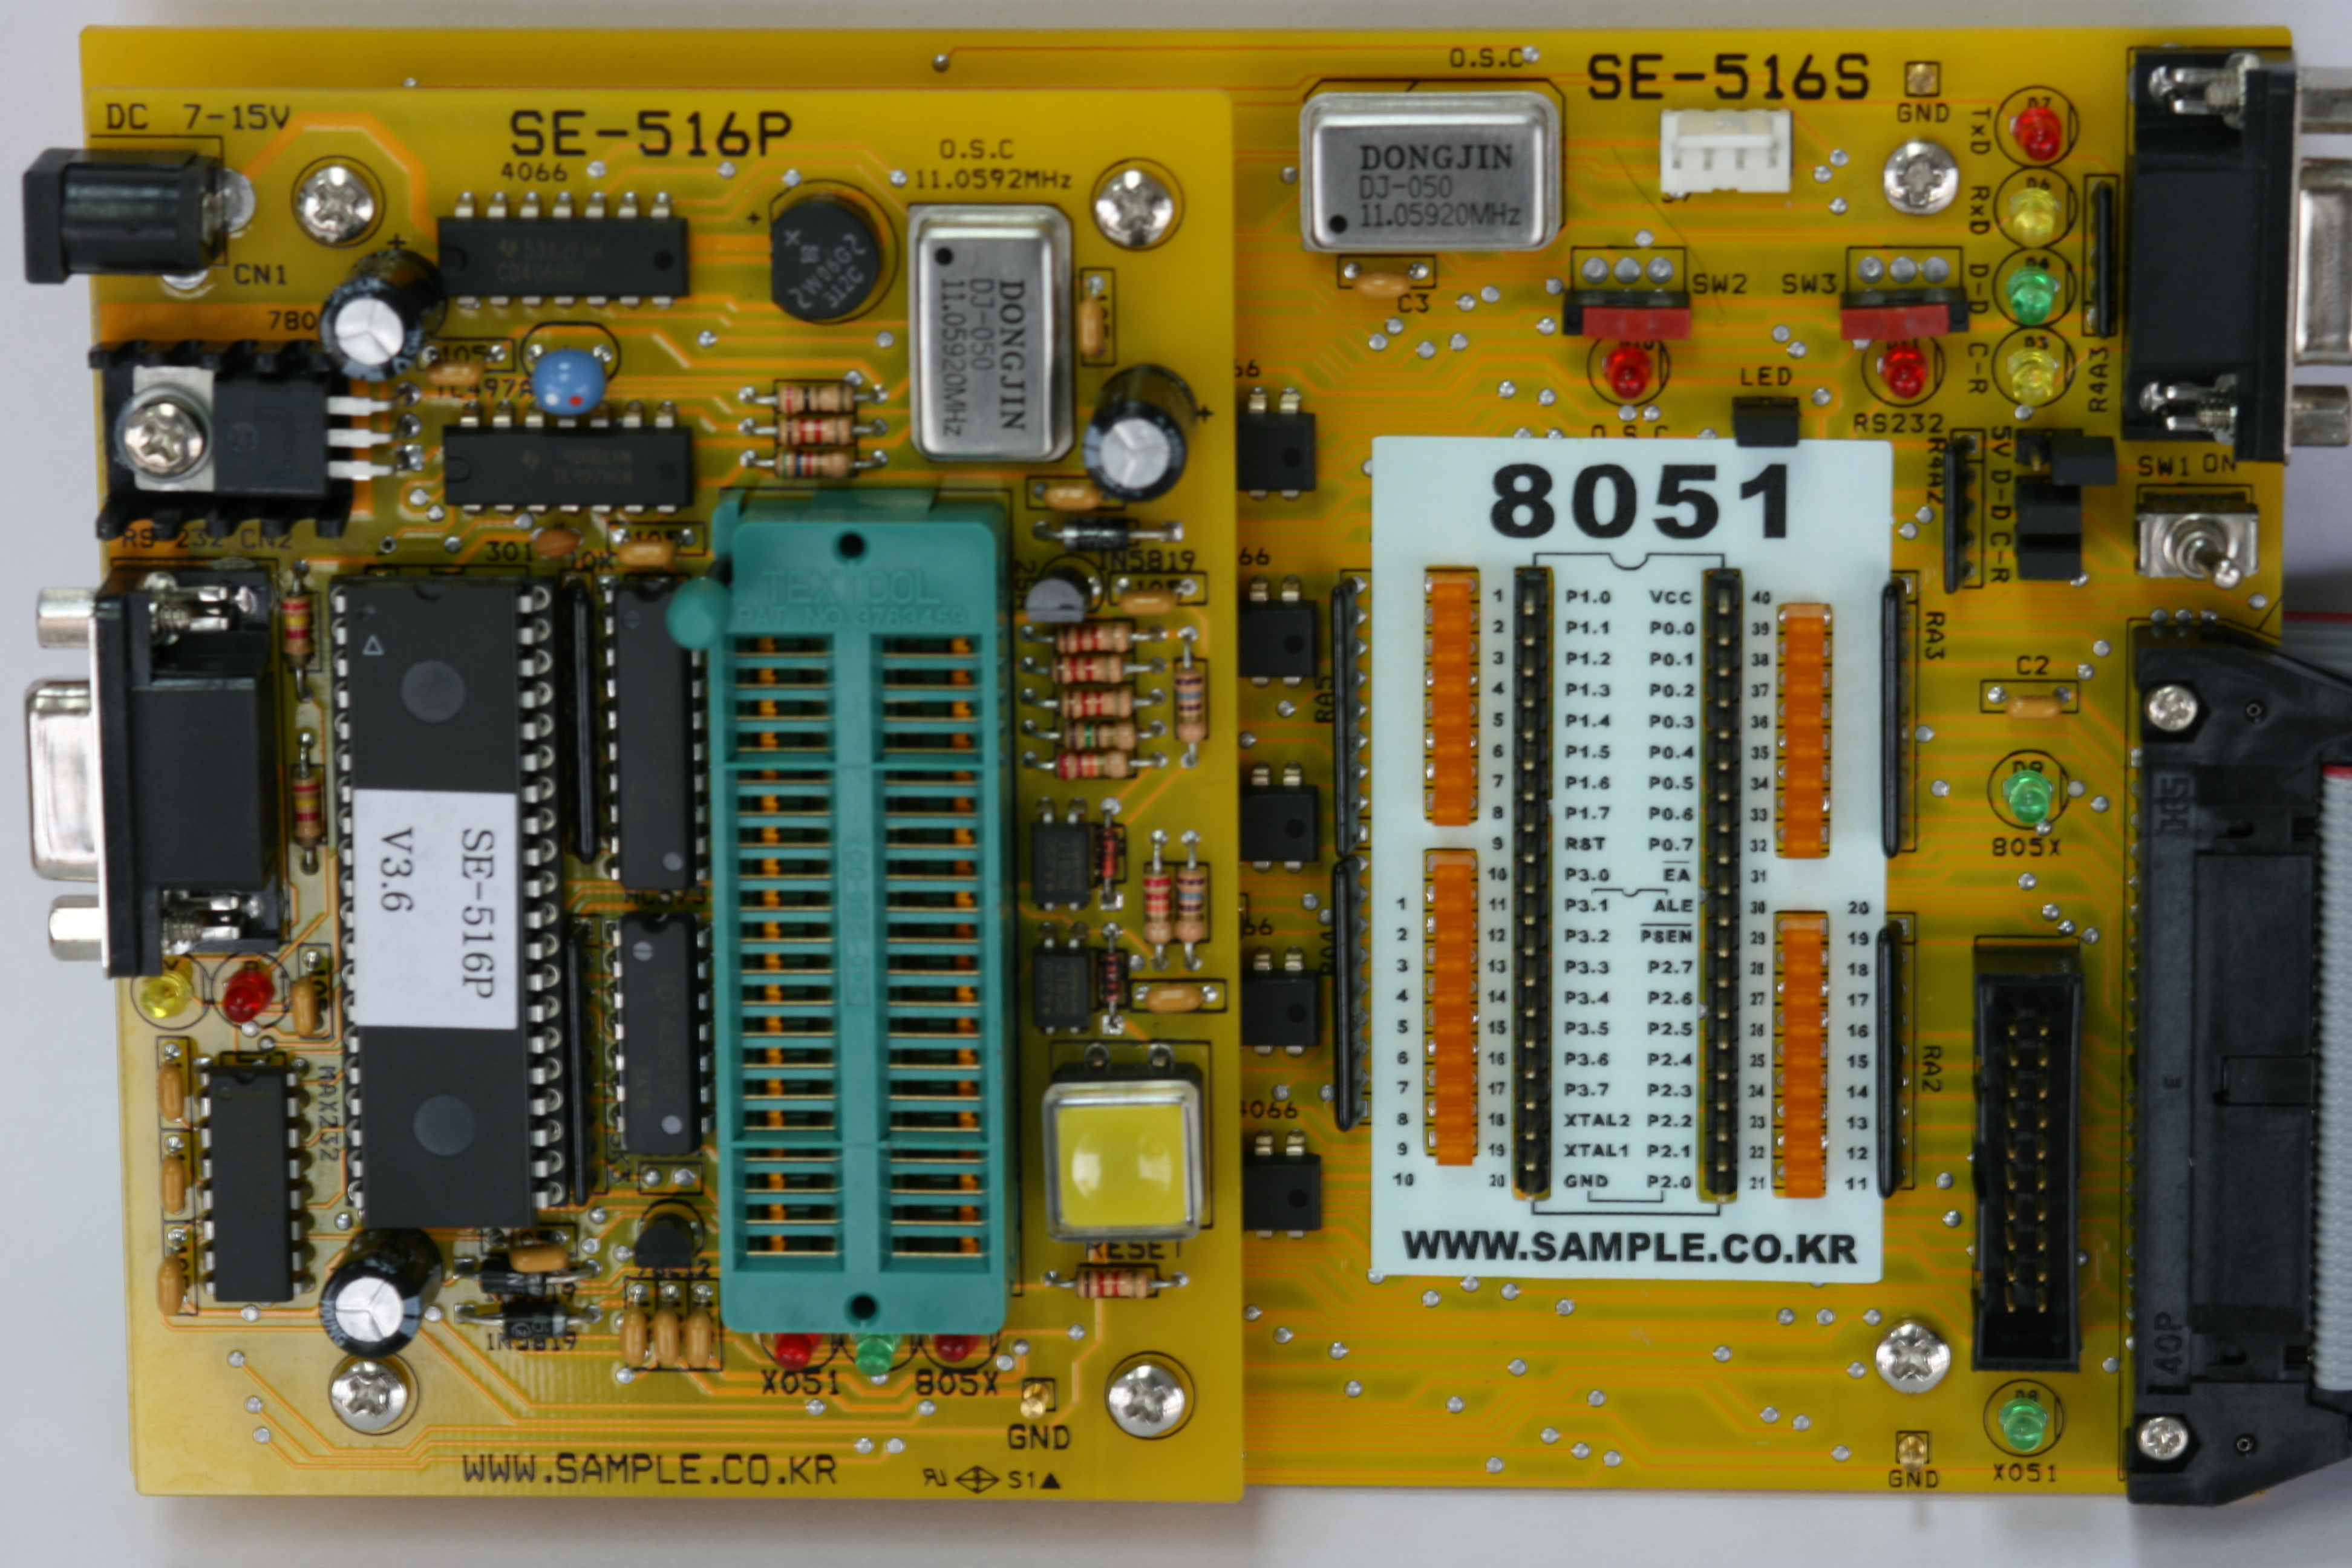
8051 Develop board

Slide 11
Issues
1. 추가 기능
  MMC 4.2 지원
  SD Card I/F 지원
2. 양산시의 Gang Writer 지원 여부
  메버릭사 와 미팅 후 세부 진행을 결정할 수 있음.
  Debugging Environment
3. MMC/SD Card 최신 표준 사양서

